Slide 1

Recommendation System Application Development by using Association Analysis Apriori Algorithm
សាកលវិទ្យាល័យ ភូមិន្ទភ្នំពេញ
ROYAL UNIVERSITY OF PHNOM PENH
SAO Kimsong
Advisor: Dr. SRUN Sovila

Slide 2
Project analysis slide 2
Contents
Introduction
Literature Reviews
Methodology
Experiments
Conclusions and Future Works

Slide 3
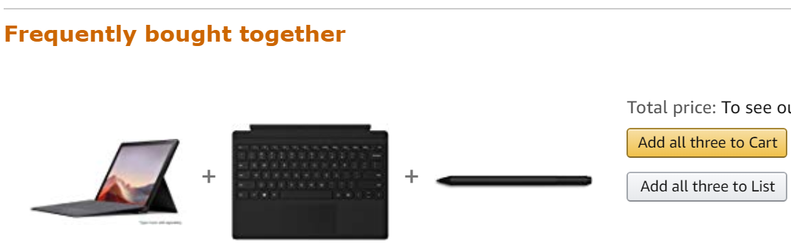
Project analysis slide 2
Introduction
E-commerce and retail companies are using the power of data and boost sales by implementing Recommendation System (RS) on their websites.
What is a RS?
Why do we need RS?
Aims of the Study
Proposed the architecture of association item analysis for the RS.
Developed and conducted experiments of RS by using Apriori Algorithm.
Notes:
Amazon can also research the profile of a customer and evaluate the reviews given by the customer.
What is a recommendation system?
A software tool that used for predicting users’ interests and recommend product items that quite likely are interesting for them.
Mining purchasing patterns allows retailers to better customize promotions and store settings.
The analysis of their customer data are useful for understanding the purchasing behavior of retail businesses.
Why Recommendations?
increasing sales as a result of very personalized offers and an enhanced customer experience.
speed up searches and make it easier for users to access content they’re interested in, and surprise them with offers they would have never searched for.
The user starts to feel known and understood and is more likely to buy additional products or consume more content.
What is a association analysis?
Use for discovering interesting relationships hidden in large data sets.
Relationships can be represented in the form of association rules or sets of frequent items.

Slide 4
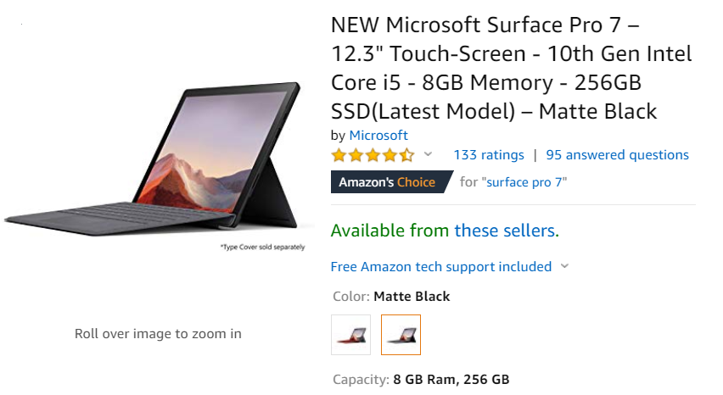
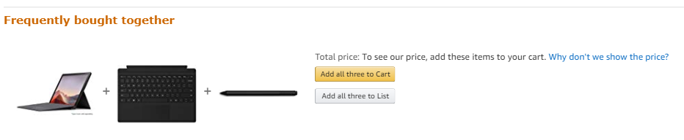
Project analysis slide 2
Introduction
Amazon Recommendation
Notes:
What is a recommendation system?
Software tools and techniques.
To provide recommendations for user-friendly products.
Given aim to help their users in various decision-making processes.
Consequently, various techniques for the generation of recommendations have been developed and many of them have also been successfully deployed in commercial environments over the past decade.
What is a association analysis?
Use for discovering interesting relationships hidden in large data sets.
Relationships can be represented in the form of association rules or sets of frequent items.

Slide 5
Project analysis slide 2
Literature Reviews
Bendakir and Aimeur, 2006: Proposed a course recommendation system based on association rules for students.
Chellatamilan, 2011: Proposed an idea for building a recommendation system for the e-Learning system.
JinHyun, et al., 2016: Implemented the mobile coupon recommendation system.
Shadi, et al., 2018: Proposed a new recommender framework for requirements engineering.
Aijaz, et al., 2018: Proposed technique for recommender system be using Opinion Based.
Notes:
Bendakir and Aimeur, 2006:
Proposed a course recommendation system based on association rules for students.
It does not make use of a student’s academic background.
Chellatamilan, 2011:
Their idea is to gather data from students using a survey questionnaire in area of educational background.
In addition, the system analyzes students’ logs of a Learning Management System (LMS) Moodle.
The disadvantage of their proposed idea is about gather data from student.
JinHyun, et al., 2016:
Implemented the mobile coupon recommendation system.
Recommended coupons to the user based on the consumer usage pattern and cooperative filtering to collect customer data on customer visits to NFC (Near Field Communication) firms.
The recommendation system is a Java-based server program.
K-means algorithm
Shadi, et al., 2018
Proposed a new recommender framework for requirements engineering.
They used Apriori algorithm to extract rules from user requirements data not transaction database.
Aijaz, Tasleem, and Majid, 2018:
Proposed technique for recommender system be using Opinion Based.
Because they used KNN for recommendation process so it make memory intensive.

Slide 6
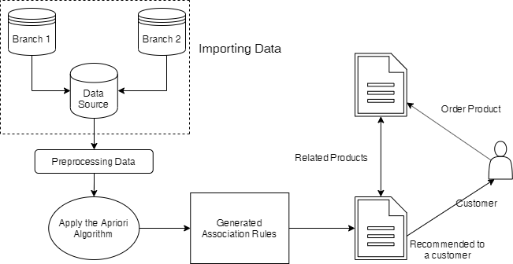
Project analysis slide 2
Methodology
System Overview

Slide 7
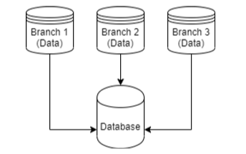
Project analysis slide 2
Methodology – Cont.
Importing Data
TID | Item
T1 | ESPRESSO
T1 | SUGAR
T1 | NEWSPAPER
T2 | ESPRESSO
T2 | SUGAR
T2 | COLA
… | …
Notes:
Collect customer purchase history data taken from any data source and import into relational database.
We need to match the data source column with our relational database formation column called target columns.
The source columns that provide must be the same size of target columns

Slide 8
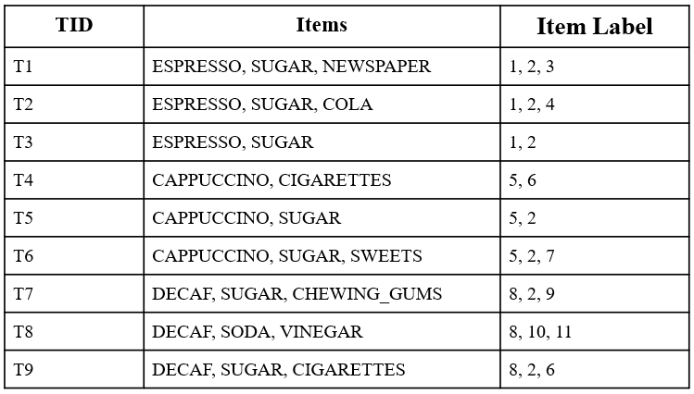
Project analysis slide 2
Methodology – Cont.
Preprocessing Data
Format transaction data to algorithm formation.
Labeled the item as a number.

Slide 9
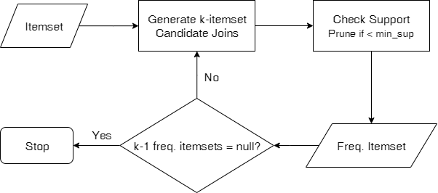
Project analysis slide 2
Methodology – Cont.
Frequent Itemset for Apriori Algorithm

Slide 10
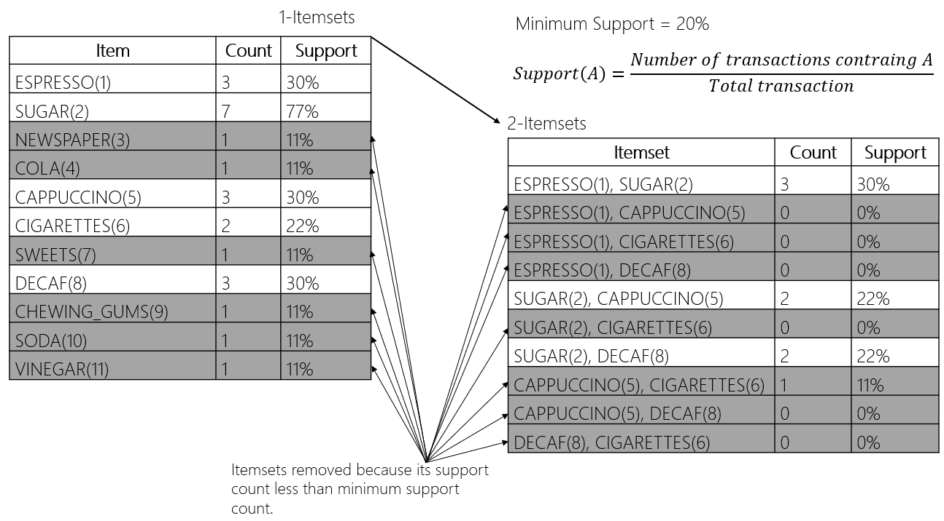
Project analysis slide 2
Methodology – Cont.
Frequent Itemset for Apriori Algorithm – Example.

Slide 11
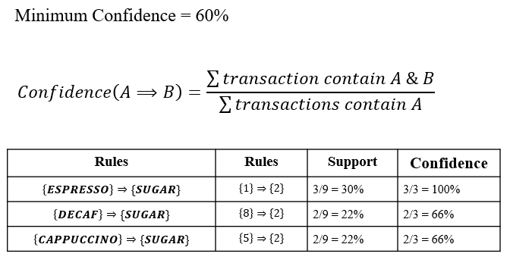
Project analysis slide 2
Methodology – Cont.
Rule Generation
Notes:
All of these association rules are considered strong because they meet the minimum confidence 60% and support 20.

Slide 12


Project analysis slide 2
Experiments
Experiment Setup
Datasets
Hardware | Software
Processor: Intel Core i5-5200U CPU @ 2.20GHz, 2 Core(s) | Windows 10 x64 Enterprise version 1809
RAM: 16GB | Python 3.7
 | PyQT5
 | QT Designer
 | Visual Studio Code
Dataset | Total Transaction | Avg. item/transaction
Dataset 1 | 4, 444 | 10
Dataset 2 | 16, 466 | 10
Notes:
We used datasets that contains 4,444 and 16,466 transactions.
The average number of items contained in a transaction is 10, while the variance is ± 7 items.

Slide 13
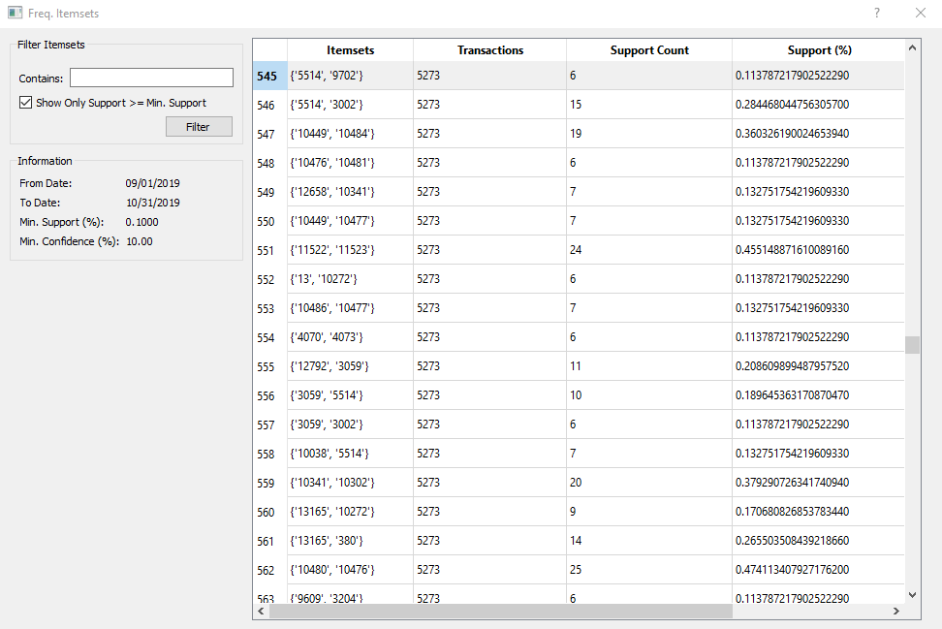
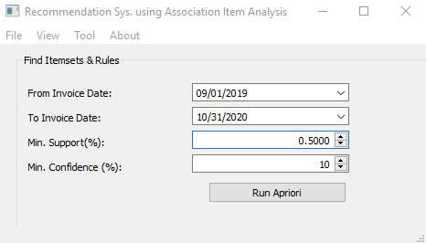
Project analysis slide 2
Experiments – Cont.
User Interface
Notes:
The performance of our implementation in means of response time (seconds) while the minimum support threshold varies from 0.5% down to 0.1%.
We observe that while the minimum support decreases, the response time of the algorithm increases.
This is expected, since lower values of minimum support result more frequent itemsets to be discovered and consequently more possible extensions.

Slide 14
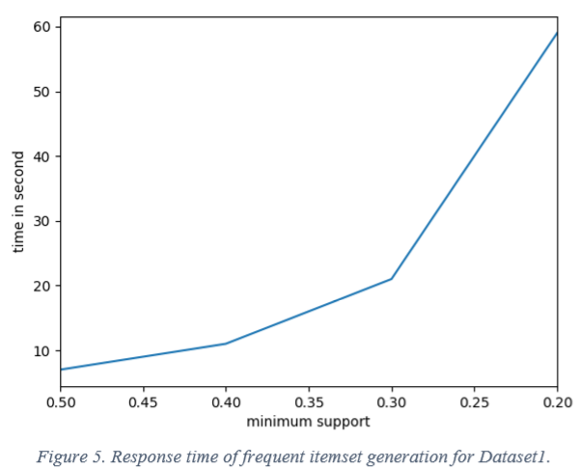
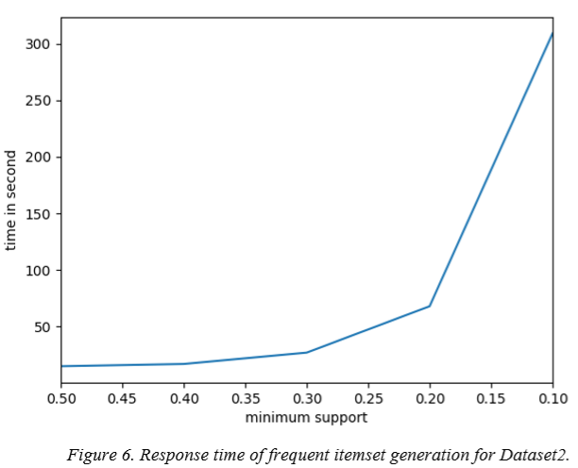
Project analysis slide 2
Experiments – Cont.
Results
Notes:
The performance of our implementation in means of response time (seconds) while the minimum support threshold varies from 0.5% down to 0.1%.
We observe that while the minimum support decreases, the response time of the algorithm increases.
This is expected, since lower values of minimum support result more frequent itemsets to be discovered and consequently more possible extensions.

Slide 15
Project analysis slide 2
Conclusions &
Future Works
Conclusions
Proposed an architecture for association item analysis for RSs.
Developed and conducted experiment of RS by using Association Analysis Apriori Algorithm.
The results can provide recommended a new item to customers by understanding historical transaction data.
Future Works
Make a library for recommend product to customers by using association items from our proposed frameworks.

Slide 16
Thank You Q&A

